Slide 1

VOYAGE VISTA: ILLUMINATING INSIGHTS FROM UBER EXPEDITIONARY ANALYSIS

Slide 2
Uber is a multinational transportation network company that operates a ride-hailing platform. It was founded in 2009 by Garrett Camp and Travis Kalanick and is based in San Francisco, California. Uber provides a convenient way for individuals to request rides from drivers who use their own personal vehicles.
Uber Driver Analysis refers to the Analyzing the number of trips taken by Uber drivers can provide insights into their overall activity and the demand for rides in specific areas. Daily, Weekly, or Monthly Analysis: Uber's data can be analyzed on a daily, weekly, monthly basis to understand the trends and patterns of trip volumes. This analysis can help identify peak hours or days of high demand and optimize driver availability during those times. Trips can be analyzed based on geographic regions or specific cities to identify areas with higher demand. This analysis can help Uber drivers decide where to focus their driving efforts for maximum efficiency and profitability. The Major of our project is to use data Analyzing techniques to find unknown patterns in the Uber Drives dataset. The research is carried out on Uber drives data collected from the year 2016.

Slide 3
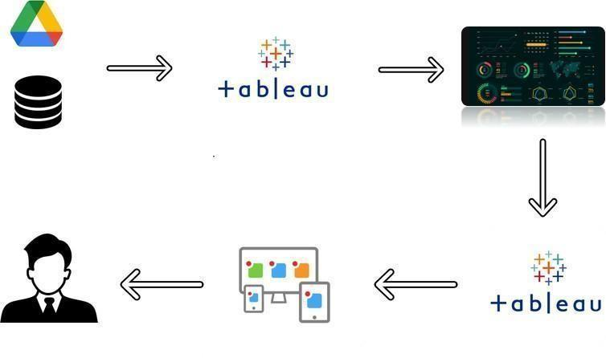

Slide 4
EMPATHY MAP AND BRAINSTORM IDEA PRIORITIZATION

Slide 5

Says
What have we heard them say? What can we imagine them saying?
Thinks
What are their wants, needs, hopes, and dreams? What other thoughts might influence their behavior?
Uber is a multinational transportation network company.
This analysis can help identify peak hours or days of high demand and optimize.
It was founded in 2009 by garrett camp and travis kalanick.
Trips can be analyzed based on geographic regions.
Uber data can be analyzed on daily, weekly and monthly.
The research is carried out on uber drives data collected from the year.
Voyage vista: illuminating insight from uber expeditionary analysis
Uses data to improve and automate all aspects of uber core ridesharing products.
Poor transportation infrastructure in some cities
Door-to-door convenience, safety, and reliable quantity.
Detecting fake rides
Surge pricing, betters cars and driver ratings.
Poor fulfilment
Does
What behavior have we observed? What can we imagine them doing?
Feels
What are their fears, frustrations, and anxieties? What other feelings might influence their behavior?
See an example

Slide 6


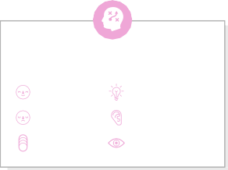



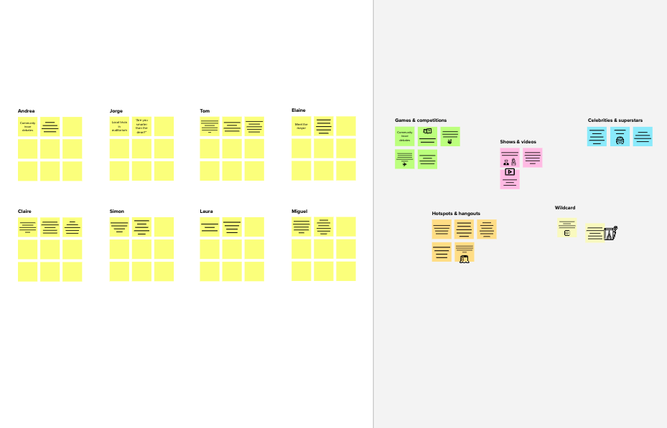
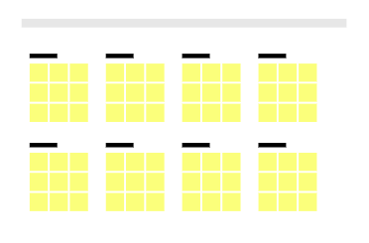
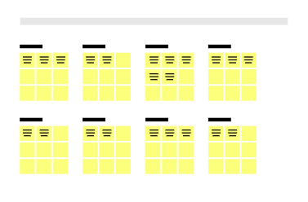


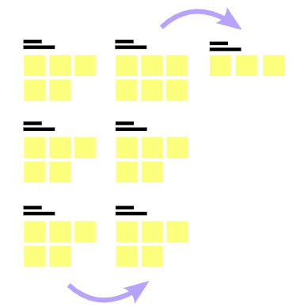
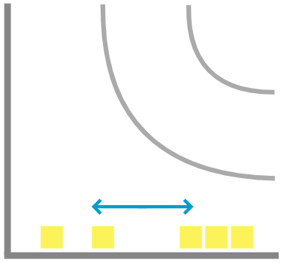
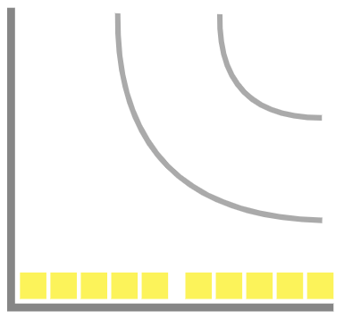
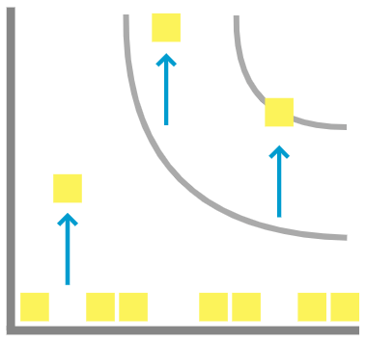
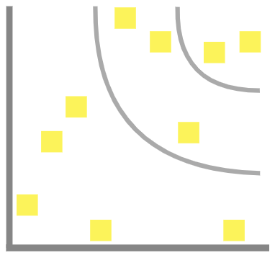

Template
4
TIP
Participants can use their cursors to point at where sticky notes should go on the grid. The facilitator can confirm the spot by using the laser pointer holding the H key on the keyboard.
1
2
3
Prioritize
Your team should all be on the same page about what's important moving forward. Place your ideas on this grid to determine which ideas are important and which are feasible.
Before you collaborate
A little bit of preparation goes a long way with this session. Here’s what you need to do to get going.
10 minutes
Define your problem statement
What problem are you trying to solve? Frame your problem as a How Might We statement. This will be the focus of your brainstorm.
Brainstorm
Write down any ideas that come to mind that address your problem statement.
TIP
You can select a sticky note and hit the pencil [switch to sketch] icon to start drawing!
Group ideas
Take turns sharing your ideas while clustering similar or related notes as you go. Once all sticky notes have been grouped, give each cluster a sentence-like label. If a cluster is bigger than six sticky notes, try and see if you and break it up into smaller sub-groups.
TIP
Add customizable tags to sticky notes to make it easier to find, browse, organize, and categorize important ideas as themes within your mural.
After you collaborate
You can export the mural as an image or pdf to share with members of your company who might find it helpful.
5 minutes
10 minutes
20 minutes
20 minutes
Brainstorm
& idea prioritization
Use this template in your own brainstorming sessions so your team can unleash their imagination and start shaping concepts even if you're not sitting in the same room.
Uberdriveranalysis
referstotheanalyzing
thenumberoftrips
takenbyuberdrivers
canprovideinsights
intotheiroverallactivity
andthedemandfor
ridesinspecificareas.
+
Daily, weekly, or monthly analysis: uber data can be analyzed on a daily, weekly, monthly basis to understand the trends and patterns of trip volumes.
Quick add-ons
_{A} Team gathering
Define who should participate in the session and send an invite. Share relevant information or pre-work ahead.
Person 1
Person 2
Person 3
Person 4
Daily, weekly, or monthly analysis: uber data can be analyzed on a daily, weekly, monthly basis to understand the trends and patterns of trip volumes.
A ^{Share the mural}
Share a view link to the mural with stakeholders to keep
them in the loop about the outcomes of the session.
Uberprovidesa convenientway forindividuals torequest rides from drivers.
Thisanalysis canhelpidentify peakhoursor daysofhigh demand.
Themajorofour projectistouse dataanalyzing techniquestofind unknownpatterns intheuberdrives dataset.
Uberdriver analysisrefers totheanalyzing thenumberof trips.
Uberprovidesa convenientway forindividuals torequest rides from drivers.
_{B} Set the goal
Think about the problem you'll be focusing on solving in the brainstorming session.
v
Thisanalysiscan helpuberdrivers decidewhereto focustheirdriving effortsformaximum efficiencyand profitability.
B
Export the mural
Export a copy of the mural as a PNG or PDF to attach to emails, include in slides, or save in your drive.
10 minutes to prepare
1 hour to collaborate
2-8 people recommended
C Learn how to use the facilitation tools
Use the Facilitation Superpowers to run a happy and
productive session.
Thisanalysis canhelpidentify peakhoursor daysofhigh demand.
Keep moving forward
Open article
Person 5
Person 6
Person 7
Person 8
Strategy blueprint
Define the components of a new idea or strategy.
Open the template
Key rules of brainstorming
To run an smooth and productive session
Thisanalysiscan helpuberdrivers decidewhereto focustheirdriving effortsfor maximumefficiency andprofitability.
Uberdriveranalysis
referstotheanalyzing
Themajorofour projectistouse dataanalyzing techniquestofind unknownpatterns intheuberdrives dataset.
thenumberoftrips
Customer experience journey map
Understand customer needs, motivations, and obstacles for an experience.
Open the template
Importance
If each of these tasks could get done without any difficulty or cost, which would have the most positive impact?
takenbyuberdrivers
Stay in topic.
Encourage wild ideas.
canprovideinsights
intotheiroverallactivity
Defer judgment.
Listen to others.
andthedemandfor
Go for volume.
If possible, be visual.
ridesinspecificareas.
Strengths, weaknesses, opportunities & threats
Identify strengths, weaknesses, opportunities, and threats (SWOT) to develop a plan.
Open the template
Uberdriver analysisrefers totheanalyzing thenumberof trips.
Share template feedback
-
-
Feasibility
Regardless of their importance, which tasks are more feasible than others? (Cost, time, effort, complexity, etc.)
+
Need some inspiration?
See a finished version of this template to kickstart your work.
Open example

Slide 7
VISUALIZATION

Slide 8
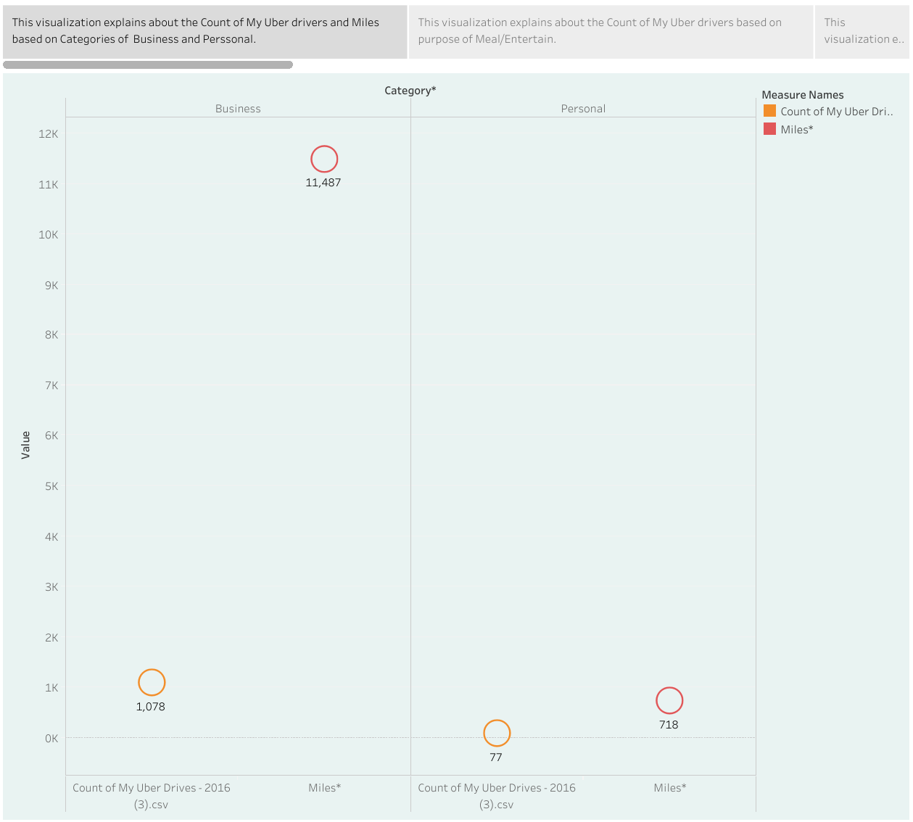
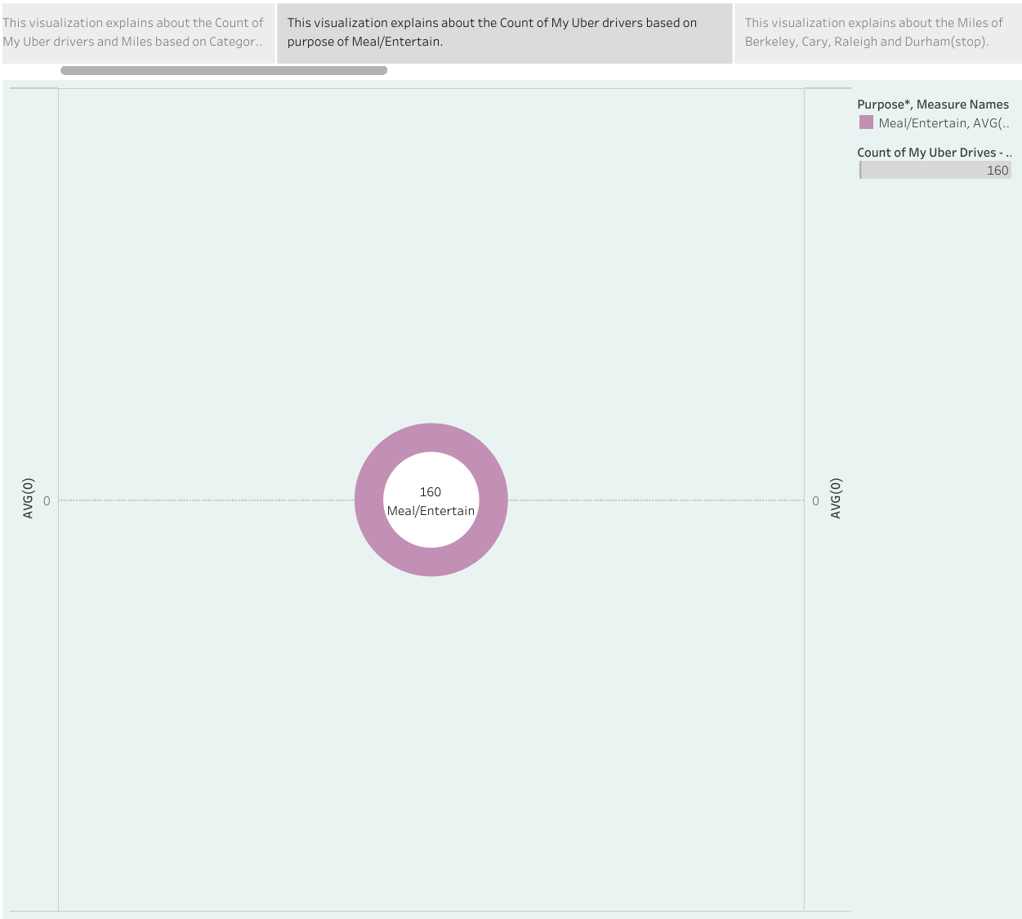
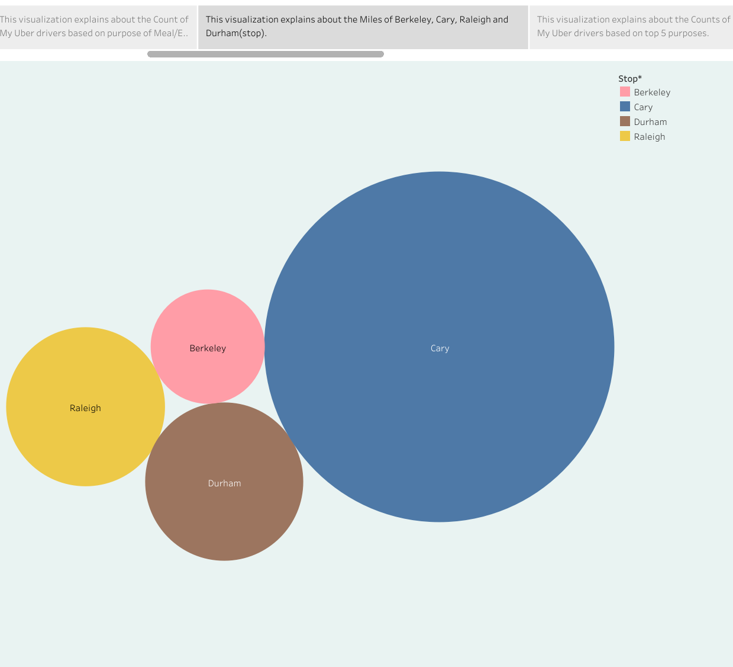

Slide 9
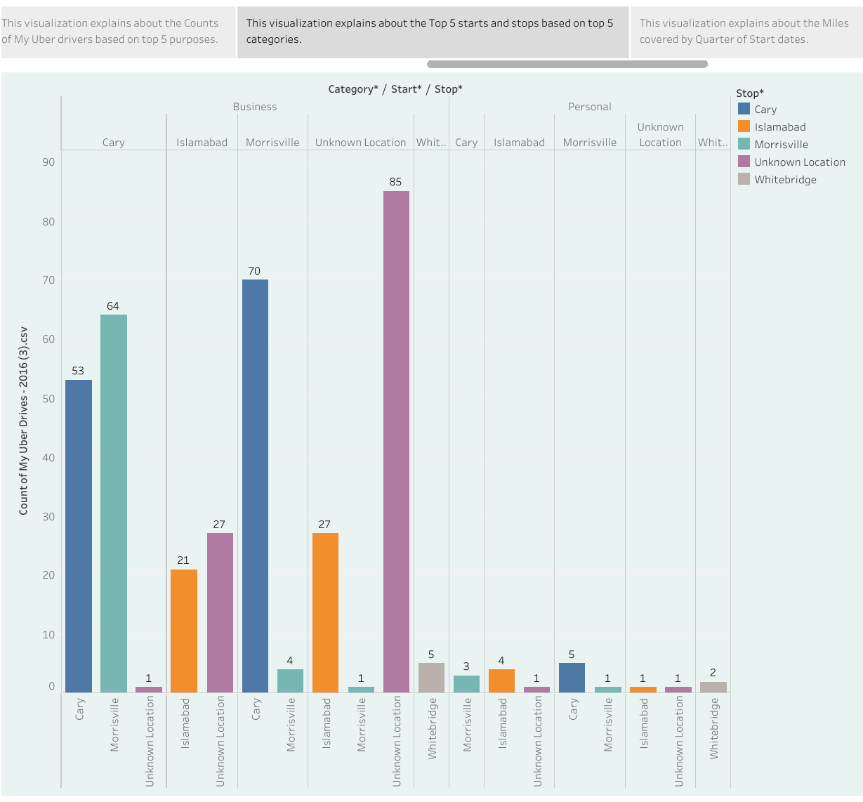
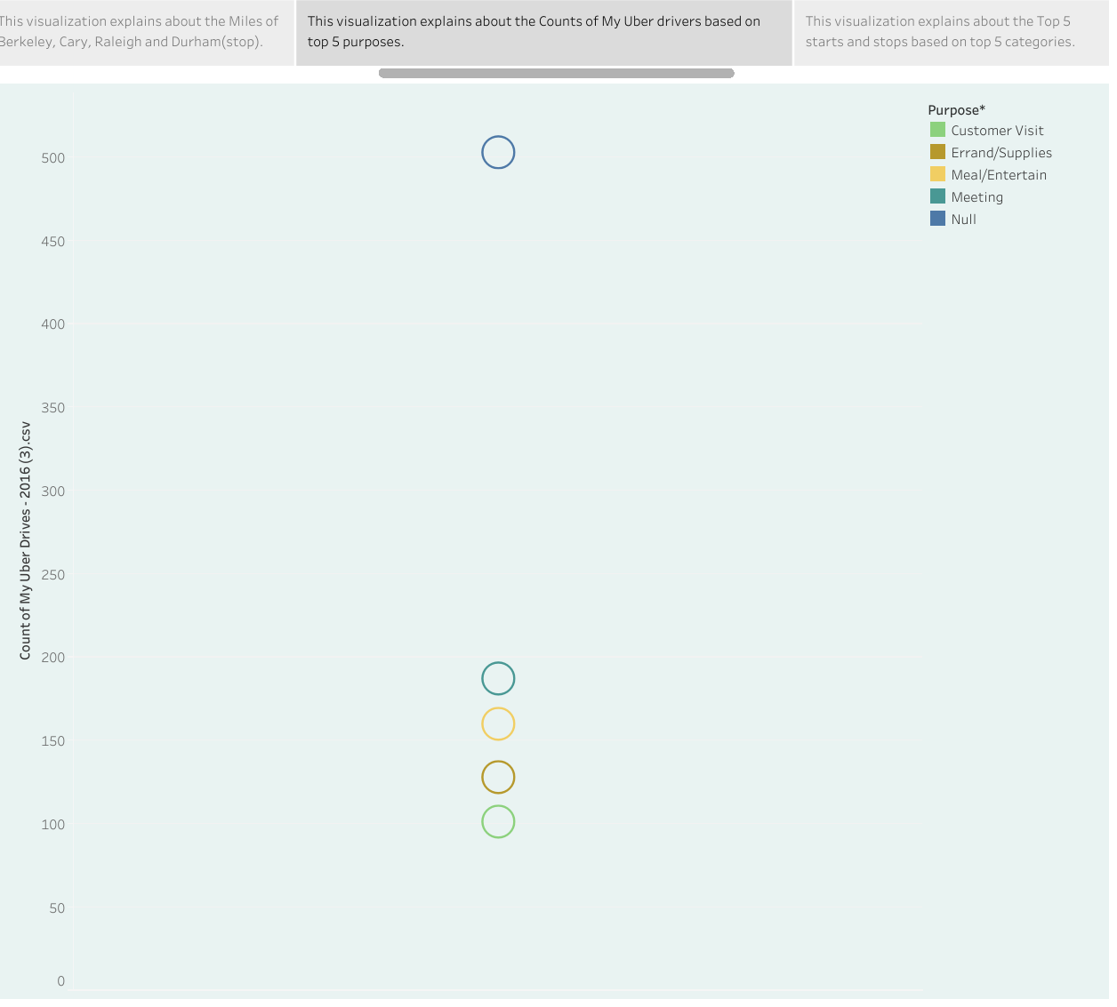
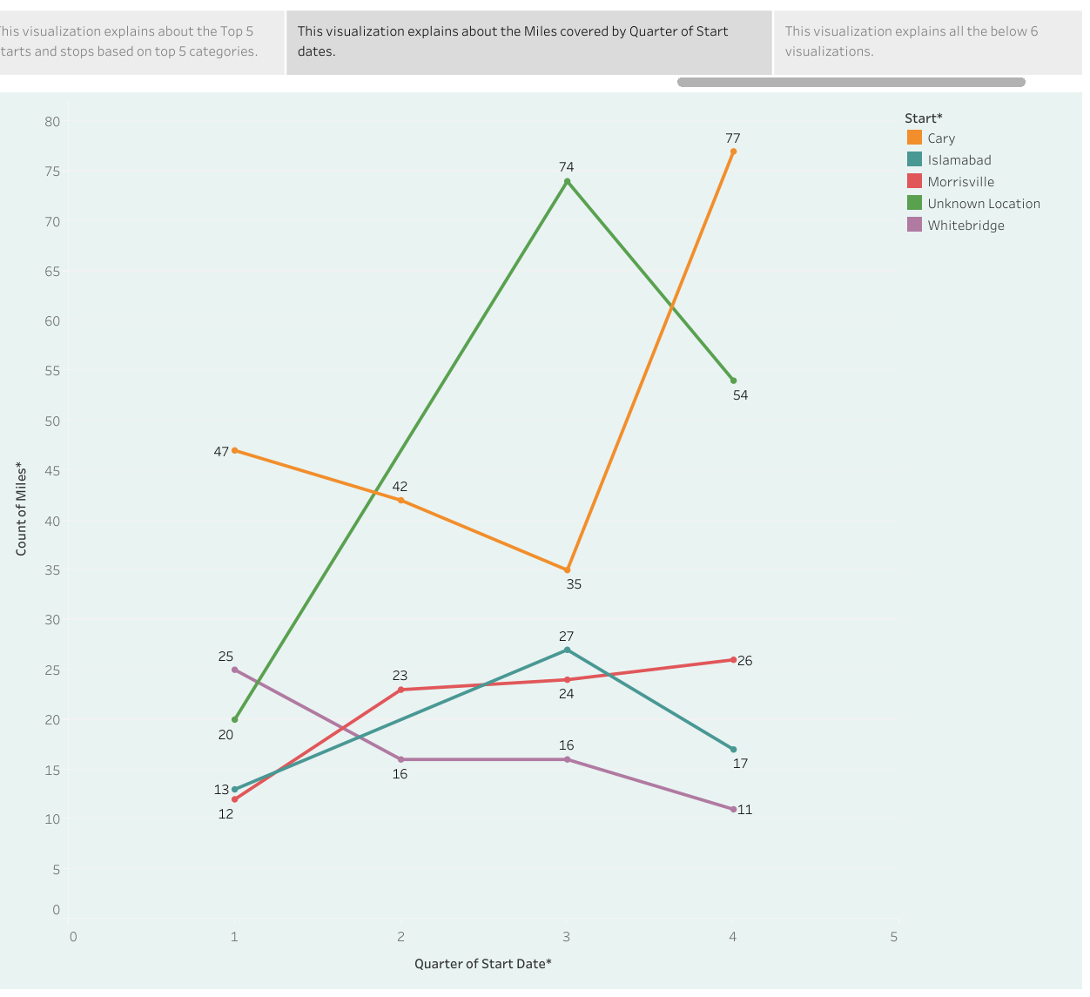

Slide 10
STORY

Slide 14
DASHBOARD

Slide 16
THANK YOU

